Slide 1
Quality Control and Assurance Strategy

Slide 2
QC Overall Goals
Identify correctable issues (e.g., data log entries, acquisition deviations)
Monitor overall quality and status of images
Provide users of data default inclusion/exclusion scheme
Notes:
2

Slide 3
QC Outline
Patient scans monitored with 2 track system
Track 1: fast, simple, and actionable quality assessment
Track 2: refinement of Track 1 measures, evaluation of usability
Phantom scans monitored for ongoing trends
Statuses and summaries communicated through online dashboards
Notes:
3

Slide 4
Patient Track 1: Fast, Simple, and Actionable
Complete within a few days of scan collection
Review scans through manual and automated methods
Provide global rating based on usability in "traffic light" scheme
Green: No known issues; default
Yellow: Minor variations/issues; correctable
Red: Significant variations/issues; not expected to be comparable
Rating is a high-level summary
A suggestions for data inclusion/exclusion but does not apply to all analyses
Notes:
4

Slide 5
Patient Track 2: Refinement of Track 1
Used only for subset of scans
Atypical acquisition (e.g., truncated functional scan)
Low rating from Track 1
Outlying image metrics (e.g., SNR)
Provides opportunity to revise rating, although not designed to alter many ratings
Instead, validate ratings and identify unexpected issues
Ratings can be downgraded according to some rule-based thresholds (e.g., problematic field-of-view)
Notes:
5

Slide 6
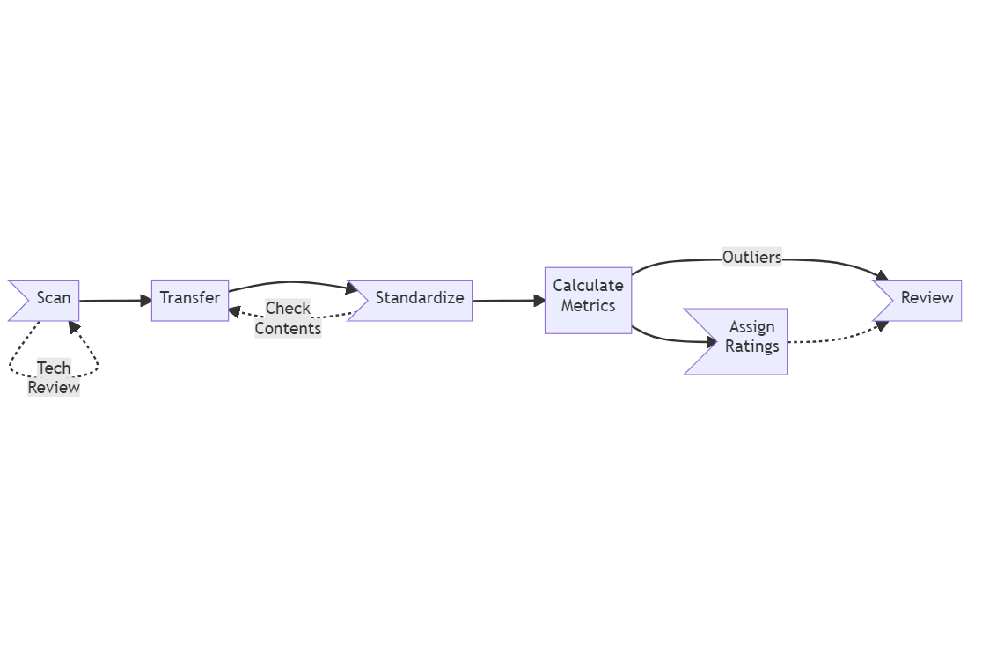
Review Tracks Organization
Track 1
Track 2
Notes:
6

Slide 7
T1w, Track 1
Initial review by technician
If first T1w red, then repeat
Review acquisition parameters
Calculate metrics (MRIQC) and look for outliers
CNR, SNR, signal summary statistics, CJV, ICVS, RPVE, QI1, QI2, INU, Template Overlap, EFC, FBER, FWHM, WM2MAX
Image Quality Rating from CAT12
Notes:
7

Slide 8
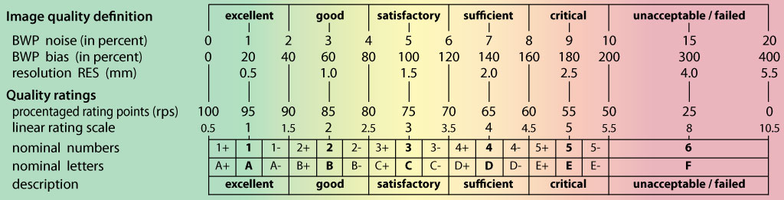
T1w, Track 1 - IQR
Designed to be predictive of GM-WM segmentation
Validated using simulations and several databases (ADNI, IXI, INDI, OASIS, PPMI)
Based on a combination of image resolution and global noise
Provides standardized rating across sites
Notes:
8

Slide 9
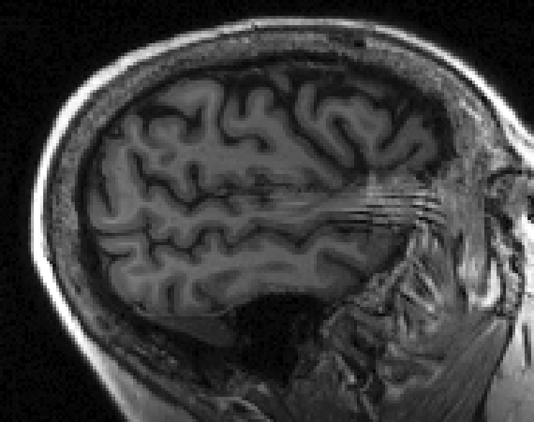
T1w, Track 2 - rule-based ratings
Field-of-View
Red: substantial wrap-around or exclusion of the cerebrum
Yellow: wrap-around that overlaps with a small portion of the cerebrum, or a field-of-view that excludes a small portion of the cerebrum
Eye spillover through PE axis
Yellow: Visible spillover
Notes:
9

Slide 10
Functional, Track 1
Review acquisition parameters
Truncated scans marked “red”
Manual review of all scans with outlying metric as calculated by MRIQC (EFC, FBER, FWHM, SNR, summary stats, DVARS, GCOR, tSNR, FD, GSR, AFNI's Outlier Ratio, AFNI's Quality Index)
Automatically assign ratings based on Framewise Displacement (Satterthwaite et al. 2012; Parkes et al. 2018)
Red: mean FD > 0.55mm
Yellow: mean FD > 0.25mm, max FD > 5mm, or percent frames above threshold > 20 (0.3mm for REST, 0.9mm for CUFF)
Green: everything else
Notes:
10

Slide 11
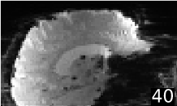
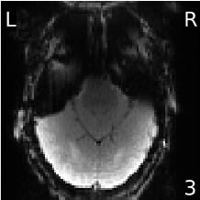
Functional, Track 2 - rule-based ratings
Field-of-View (including wrap-around)
Red: substantial wrap-around or exclusion of the cerebrum
Yellow: wrap-around that overlaps with a small portion of the cerebrum, or a field-of-view that excludes a small portion of the cerebrum
Green: wrap-around that does not overlap with the cerebrum, or a field-of-view that excludes the cerebellum
Notes:
11

Slide 12
DWI, Track 1 and 2
Review acquisition parameters
Truncated scans marked “red”
Manual review of all scans with outlying metric as calculated by QSIPrep (FD, relative FD, template overlap, neighborhood correlation, number bad slices)
Metrics calculated before and after preprocessing
Notes:
12

Slide 13
Track 2 – General Review
Manually review
scans rated “red” or “yellow”
scans with at least one outlying metric
All scans with atypical acquisition
Reviewed
T1w: 56% (100% by MRI Tech)
Functional: 25%
DWI: 13%
Review involves inspection of pipeline html reports (MRIQC, QSIPrep), supplemented with inspection of images
Notes:
13

Slide 14
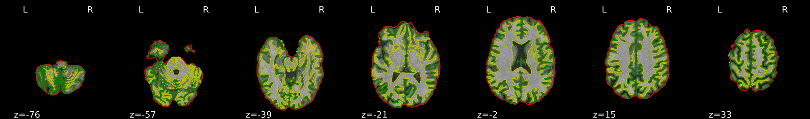
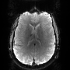
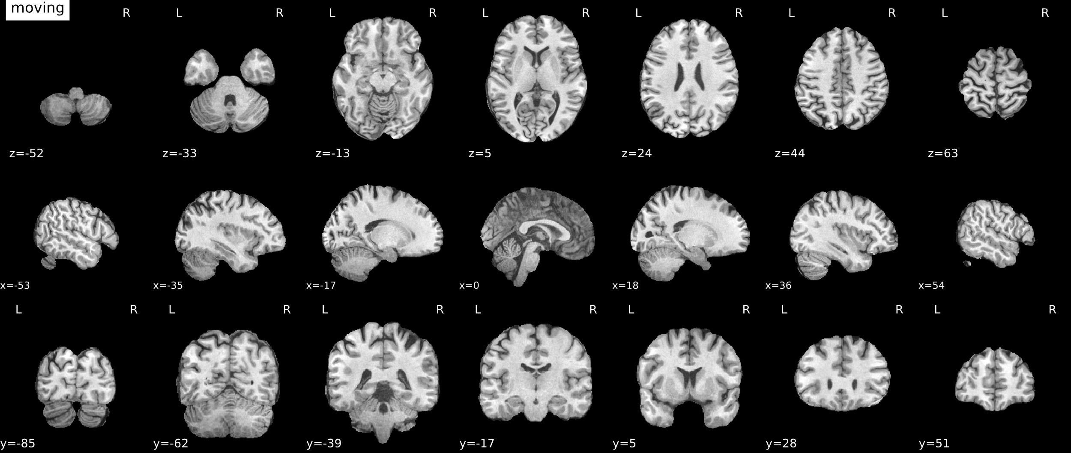
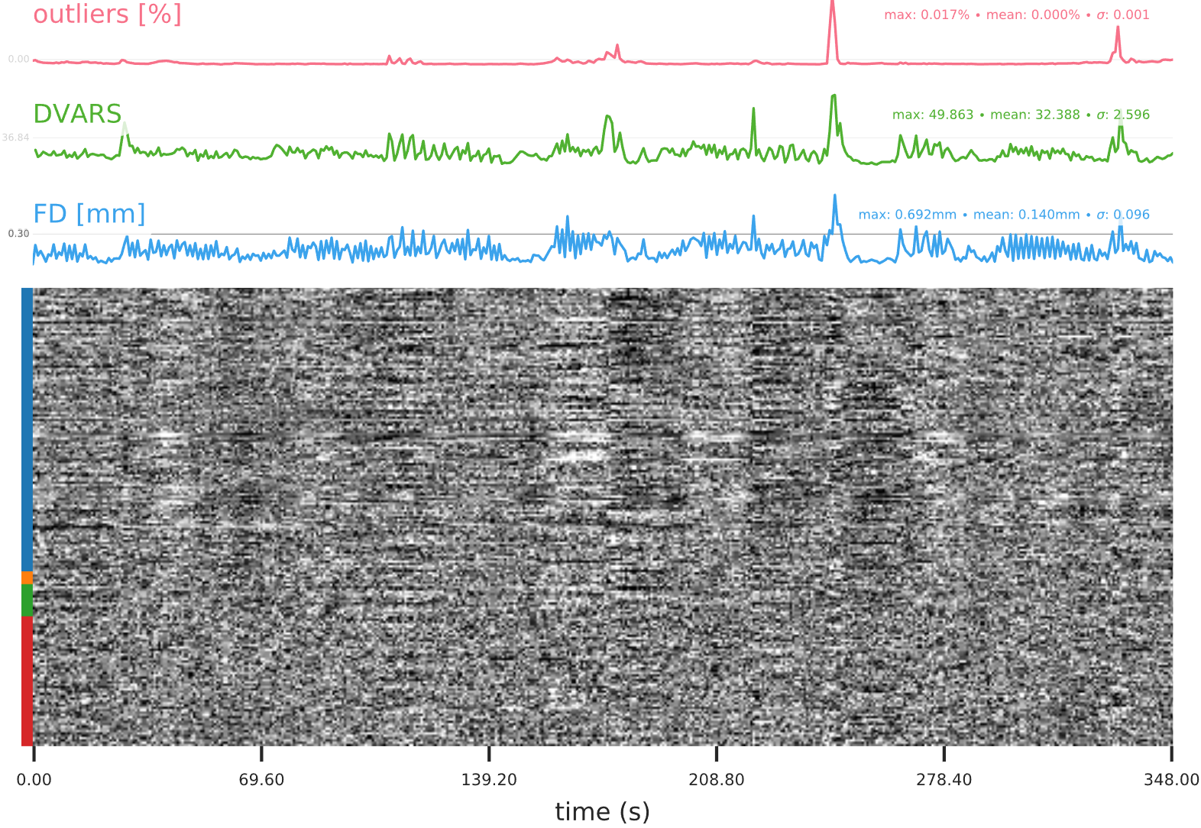
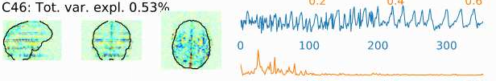
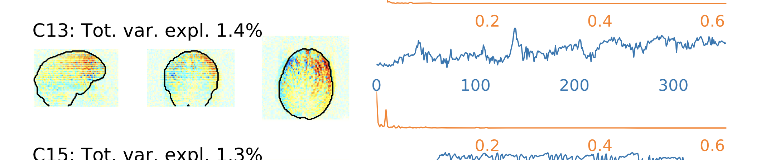
Track 2 Review primarily visual
Notes:
14

Slide 15
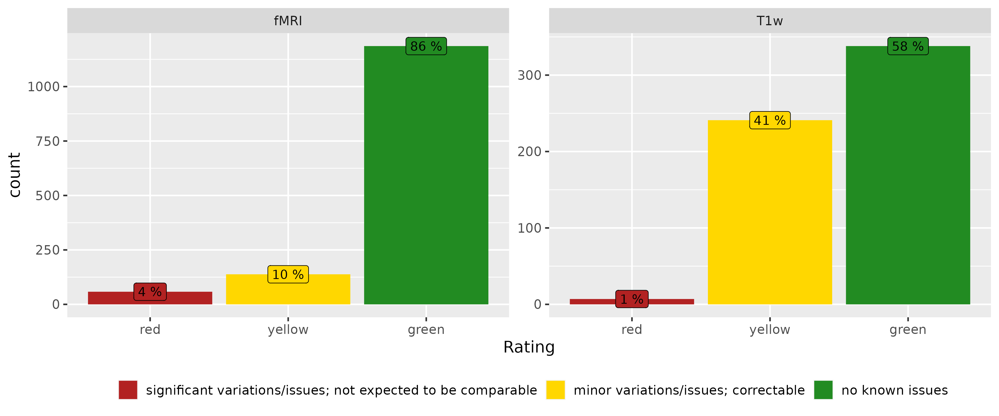
Patient Rating Results
Notes:
15

Slide 16
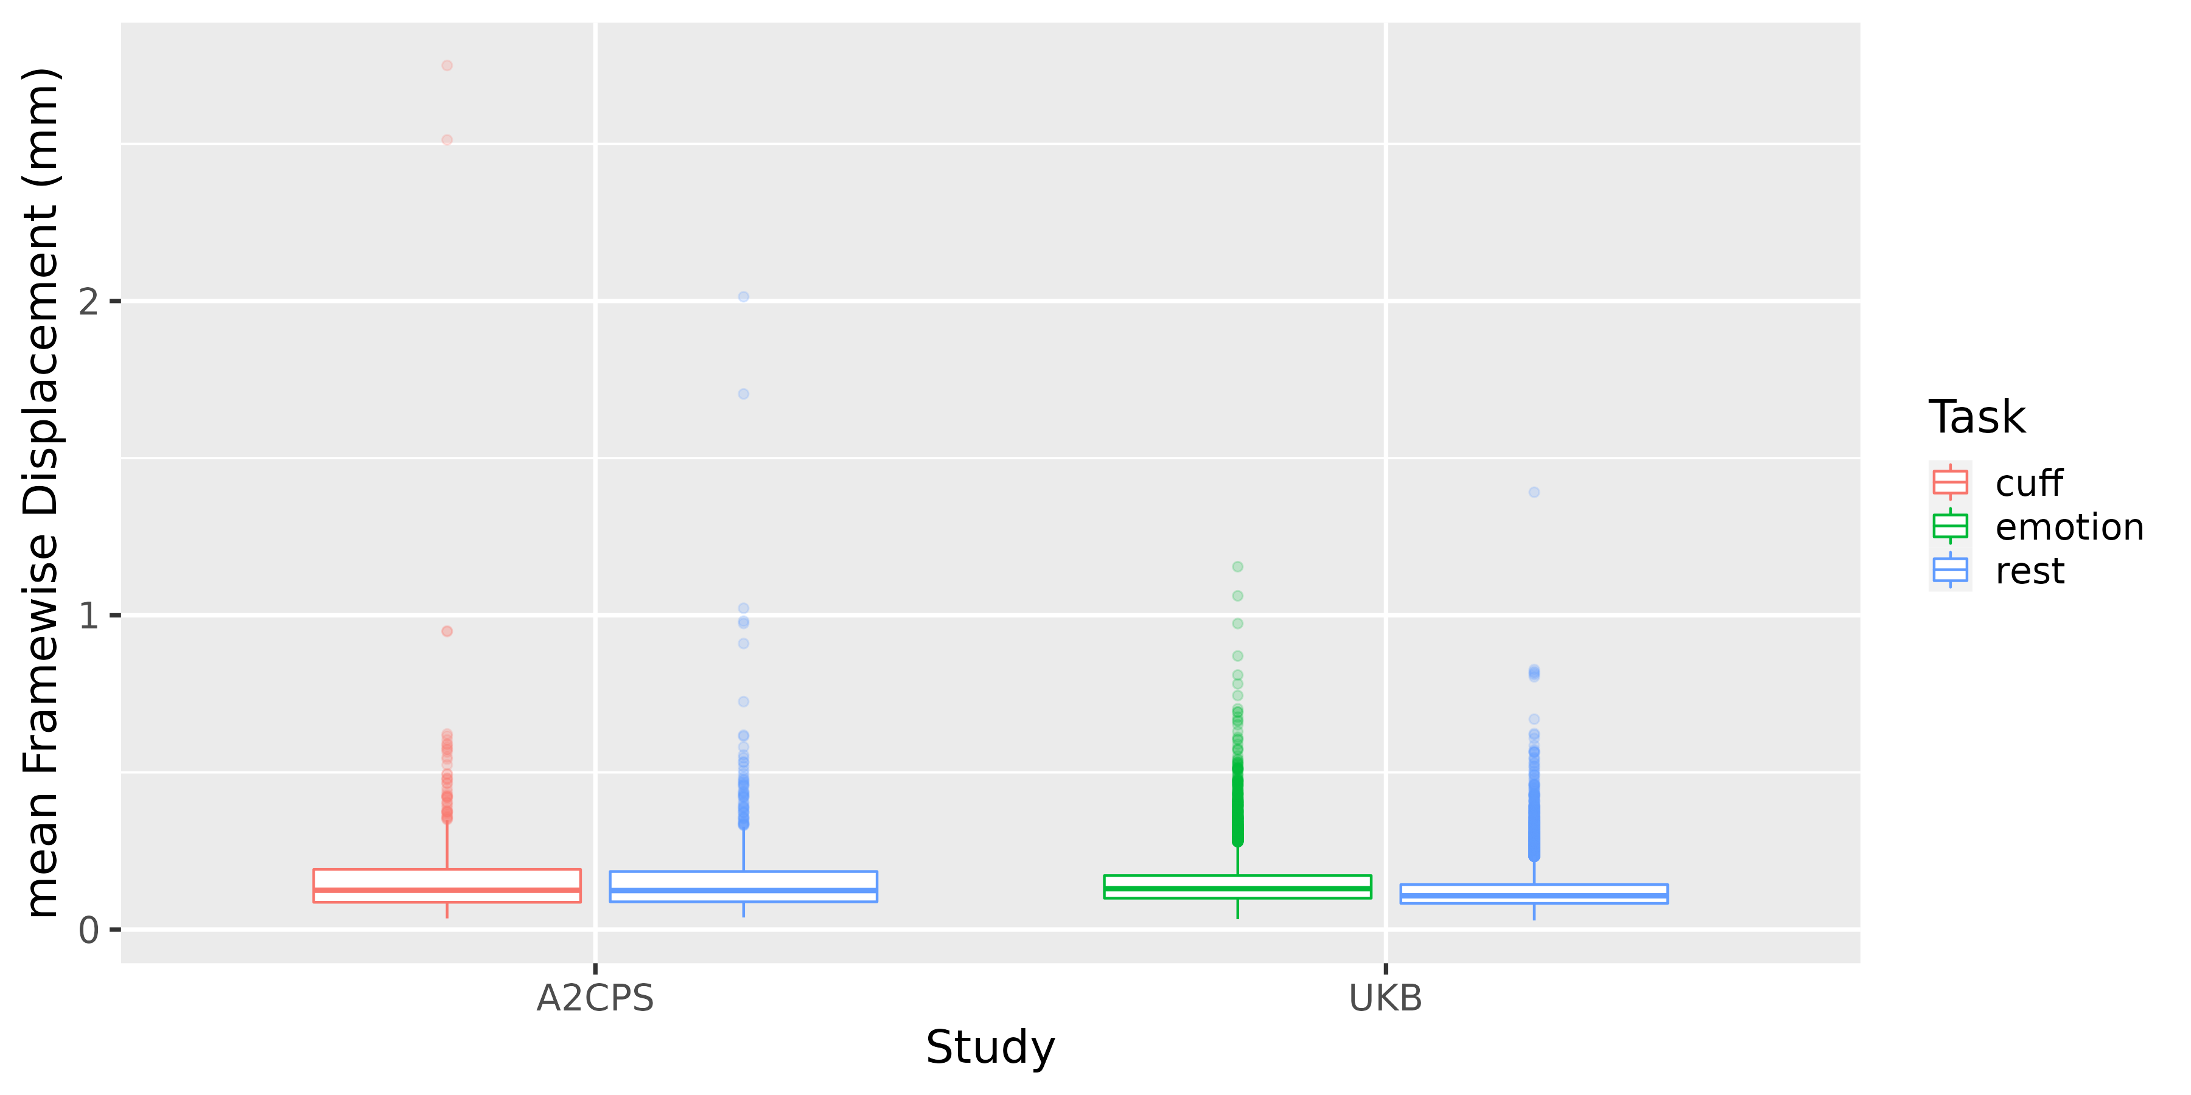
Motion Comparison
Notes:
16

Slide 17
Phantom Scans
Sites are expected to maintain internal processes for big scanner issues
Protocol matches patient scan types (T1w, DWI, functional)
Variations in acquisition parameters
Collected either weekly or after each participant
Aim: help identify subtle or long-term variations
cross-site comparison is not a goal
Notes:
17

Slide 18
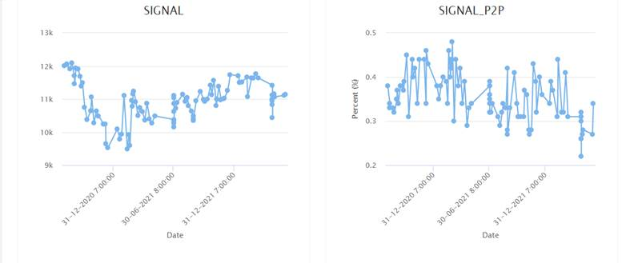
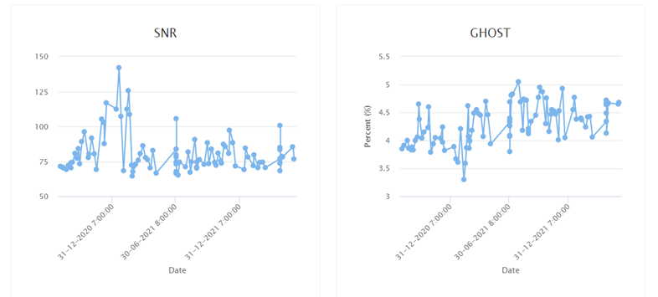
Phantom Scans – QA Measures
Current: fMRI
Signal Intensity, Signal Peak-to-Peak Intensity, Signal-to-Noise Ratio, Ghosting
Notes:
18

Slide 19
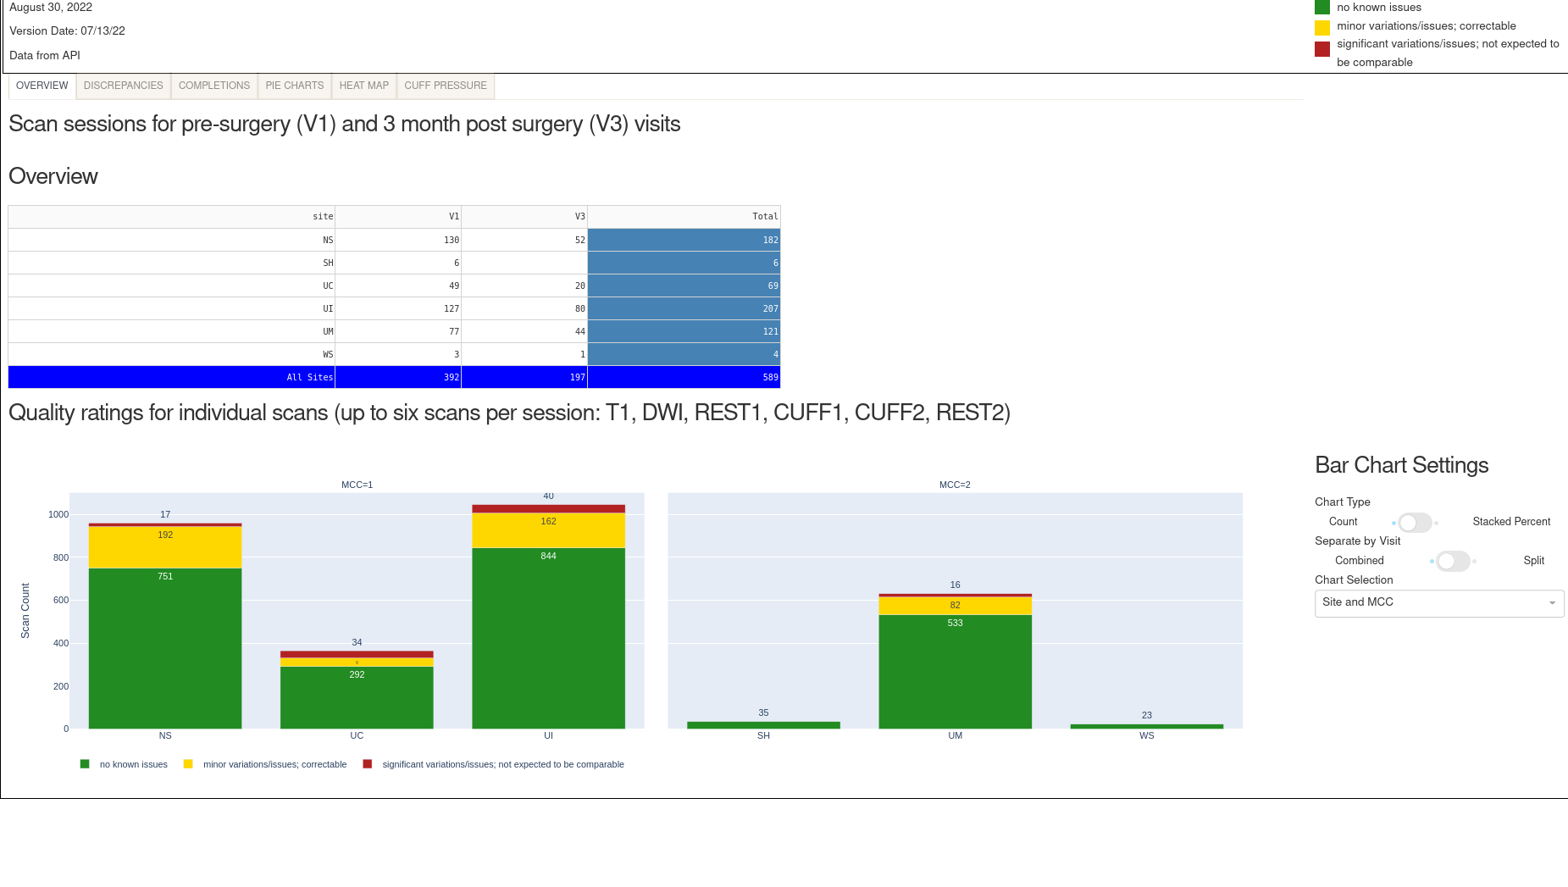
QA/QC Communication
Open communication with sites for immediate issues (e.g., corrupted data, failed transfer)
Overview current proportions of scan ratings and distribution of metrics through meetings and online dashboard
Notes:
19

Slide 20
QA/QC Summary and Discussion
Patient scans monitored with Track system
What are we overlooking? (e.g., fieldmaps, DWI, preprocessing)
Concerns about relying mainly on motion to rate functional scans?
Phantom scans will be monitored for ongoing trends
Recommendations for further processing?
Communication through online dashboard
Thoughts on the effectiveness of traffic light rating scheme?
Notes:
20

Slide 22
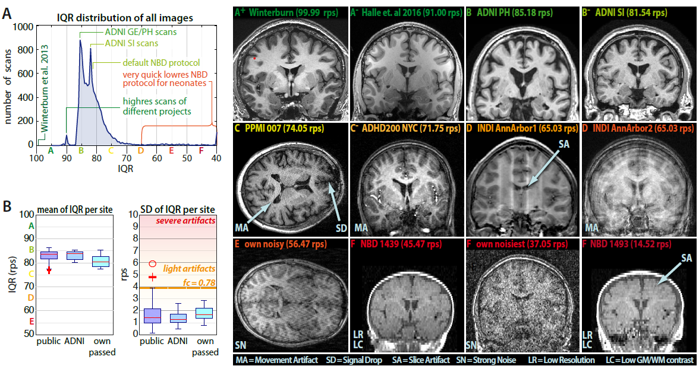
Cat12 IQR
Notes:
22

Slide 23
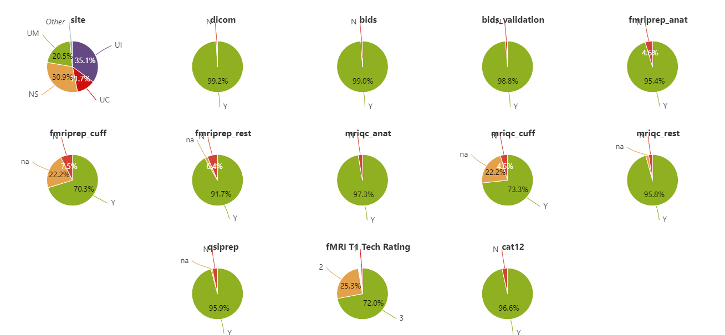
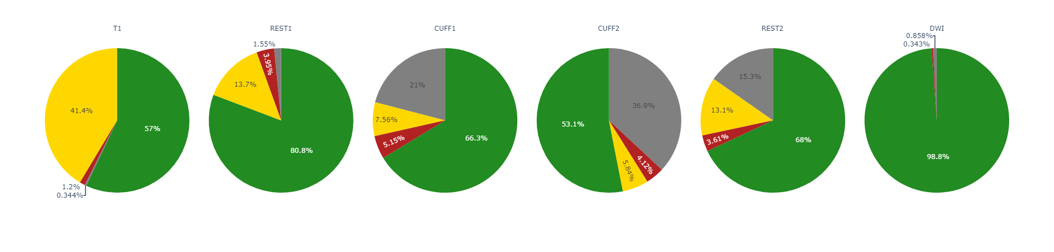
Dashboard provides space to drill into processing and rating distributions
Notes:
23

